Slide 1
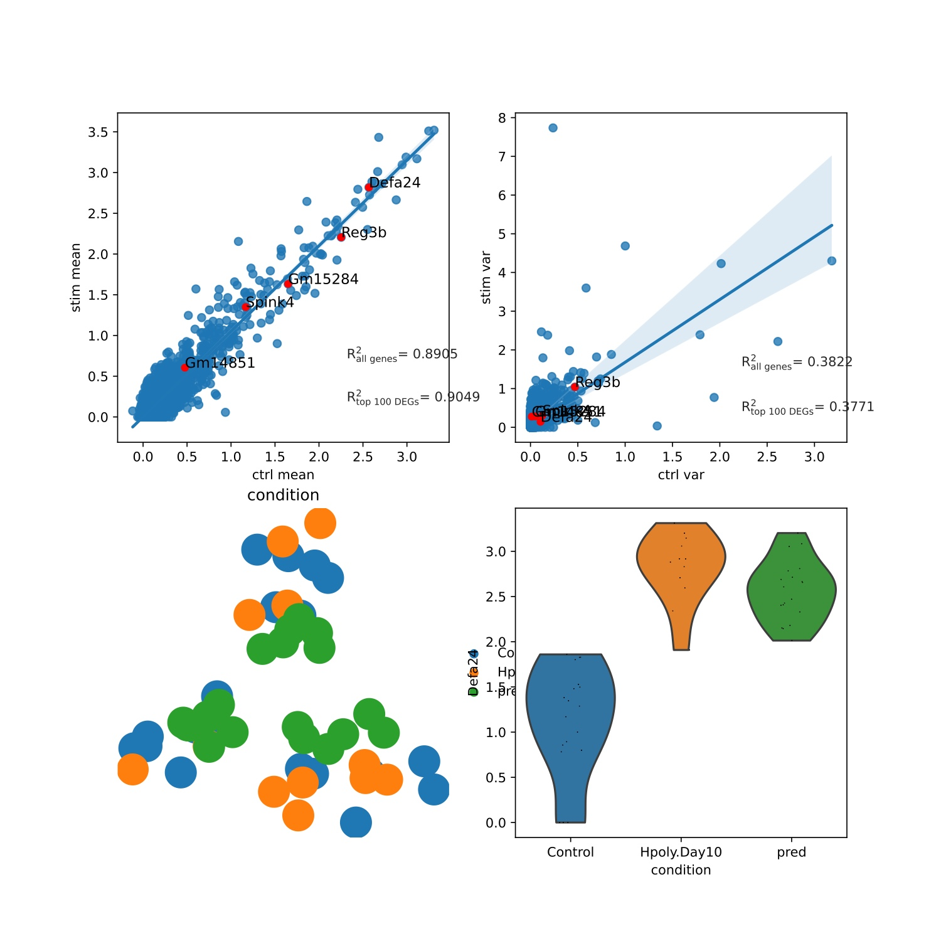
Ours
scgen
Hpoly: endocrine

Slide 2
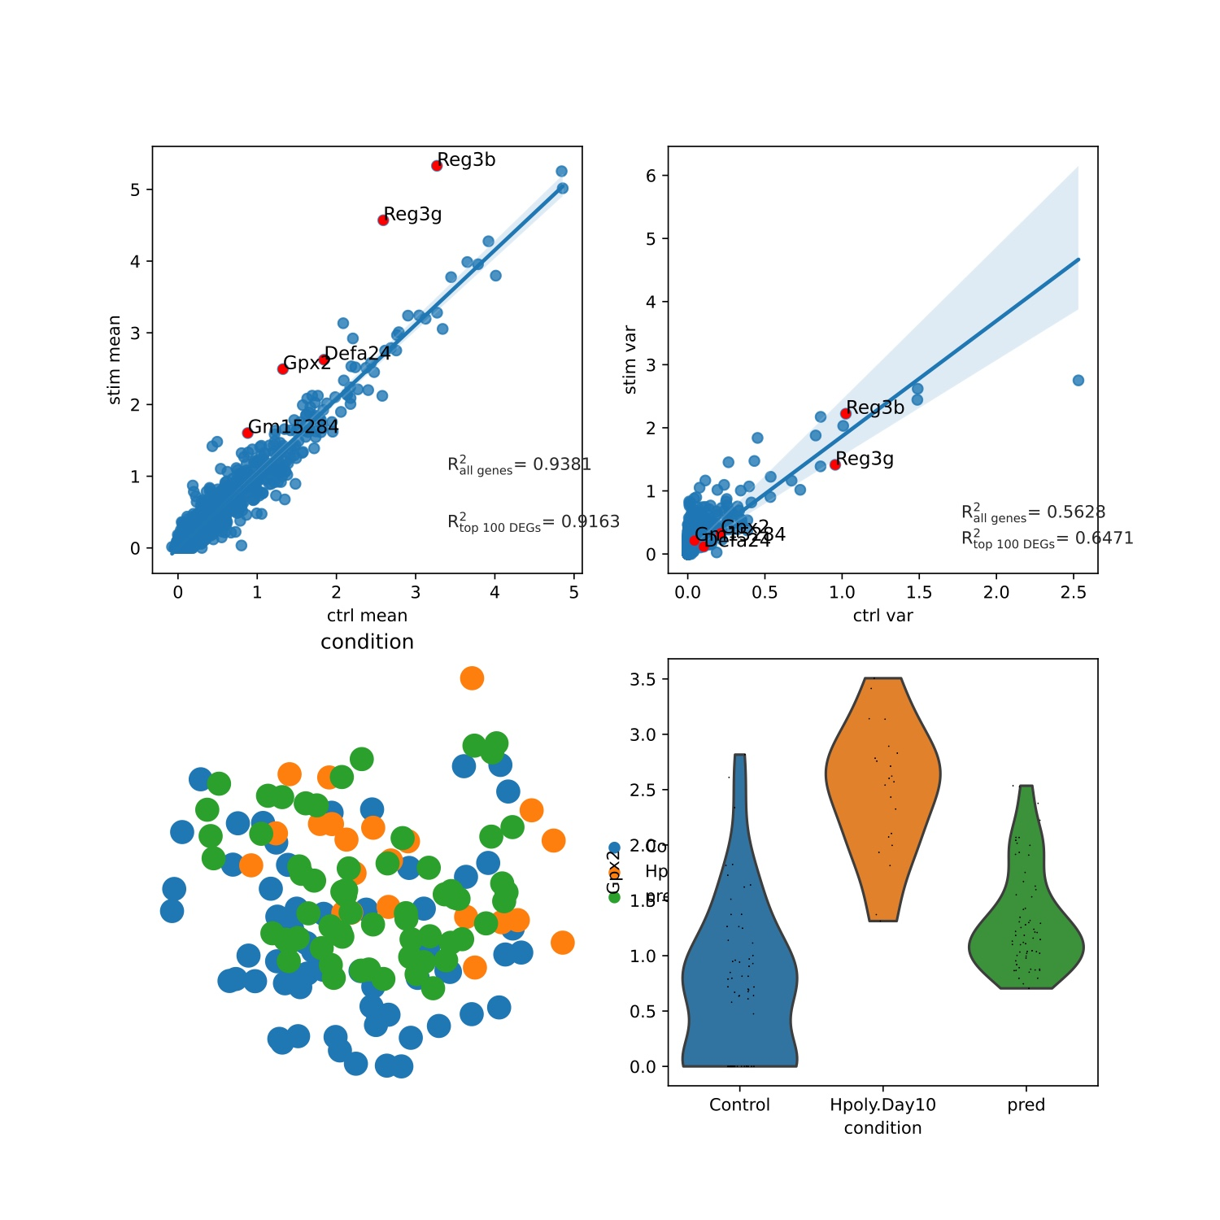
Ours
scgen
Hpoly: Enterocyte

Slide 3
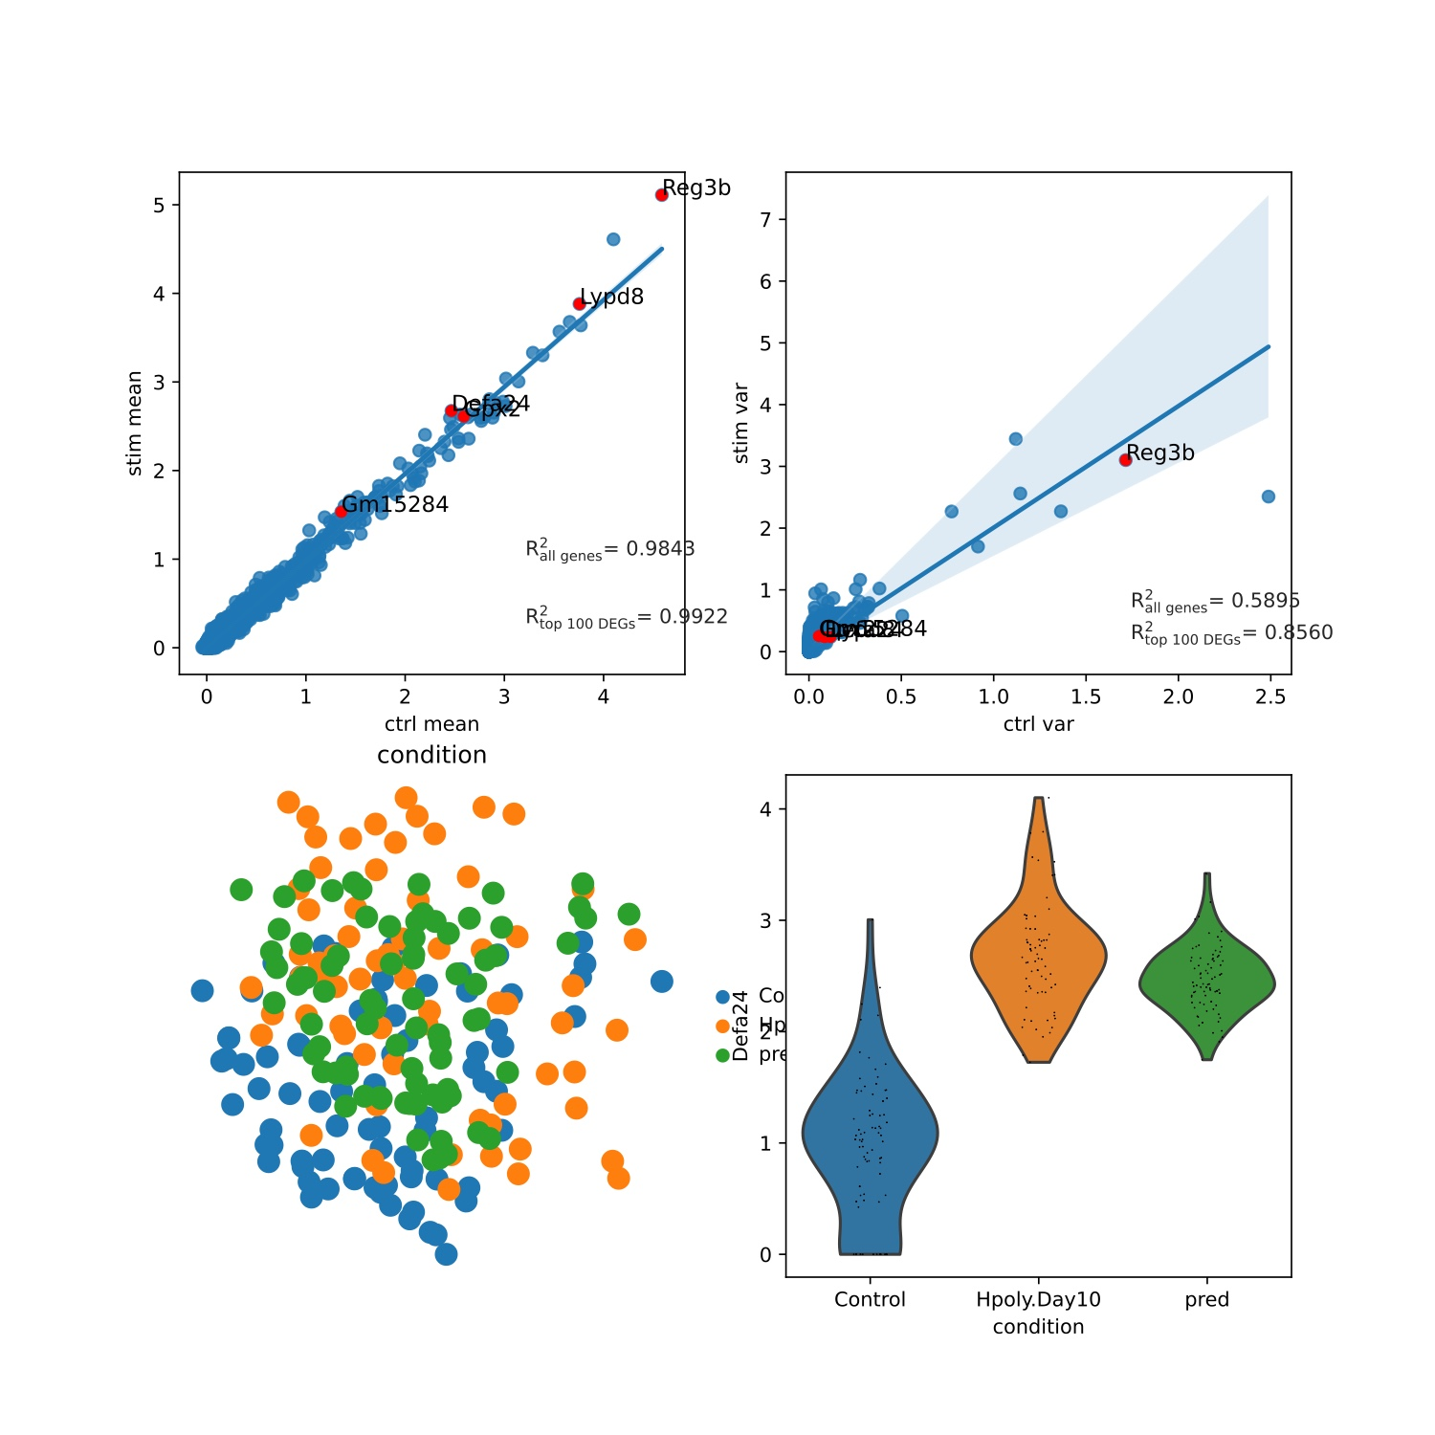
Ours
scgen
Hpoly: Enterocyte.Progenitor

Slide 4
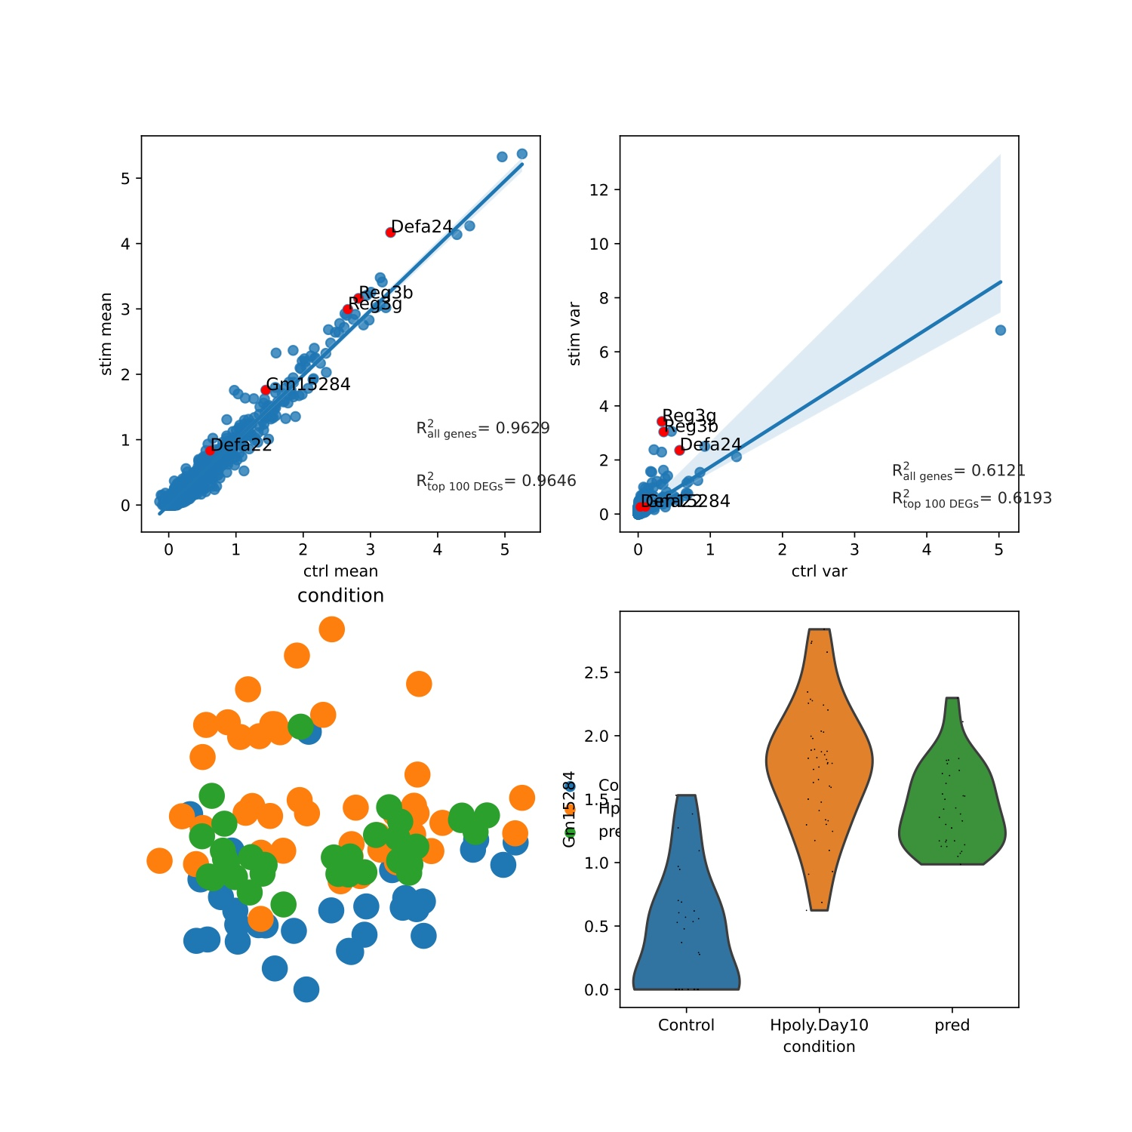
Ours
scgen
Hpoly: Goblet

Slide 5
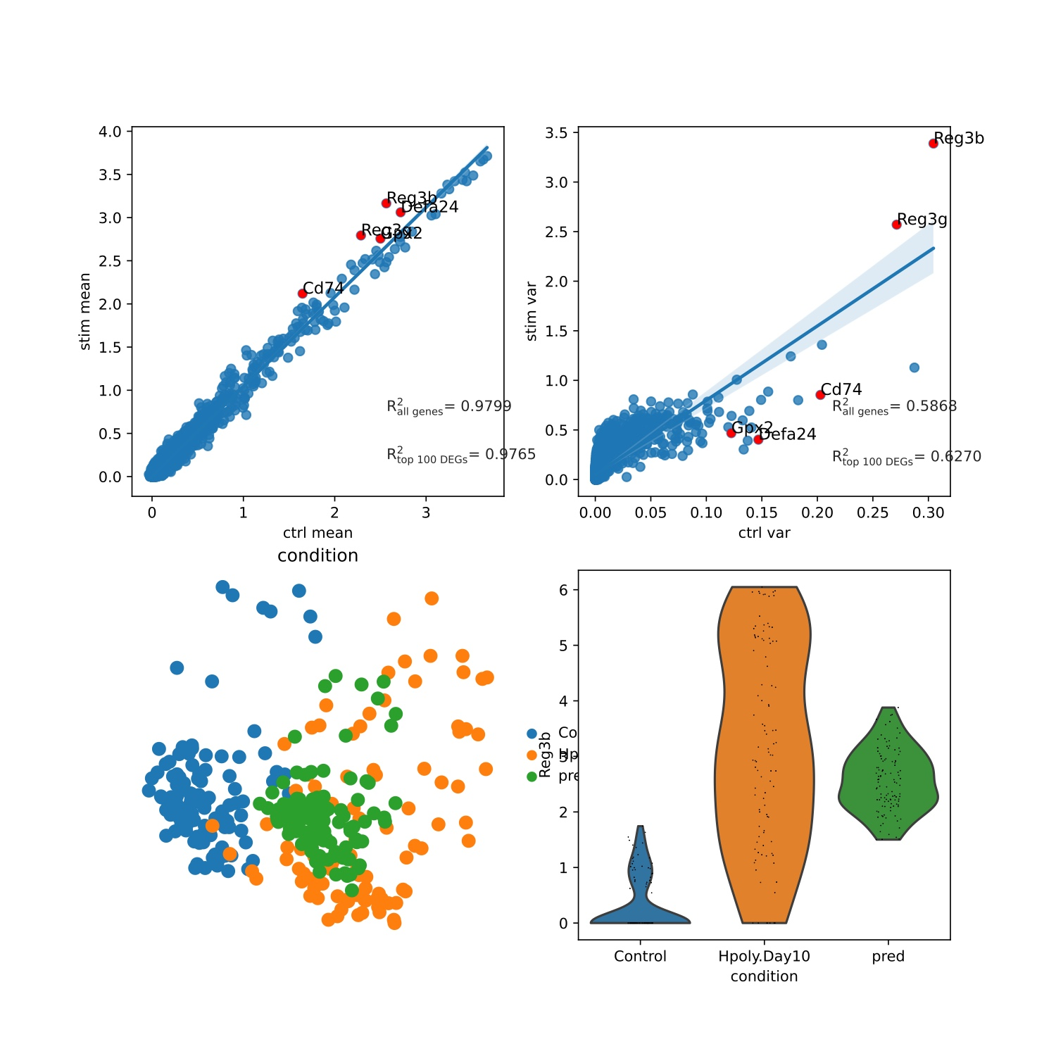
Ours
scgen
Hpoly: stem

Slide 6
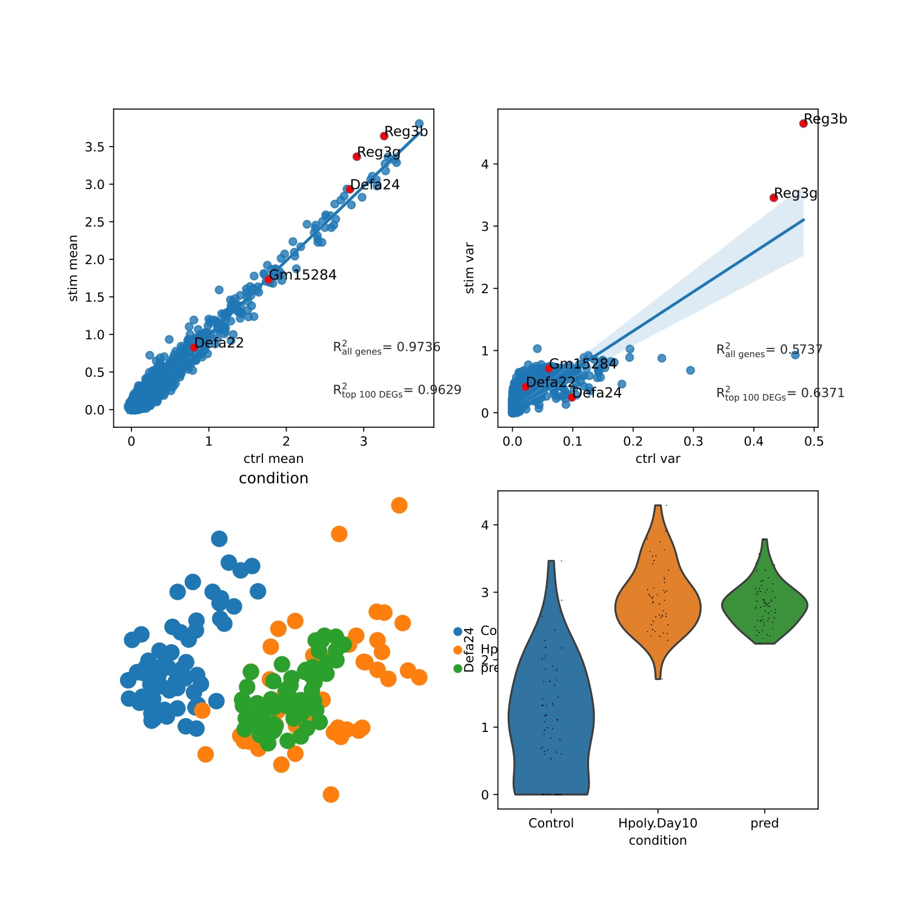
Ours
scgen
Hpoly: TA

Slide 7
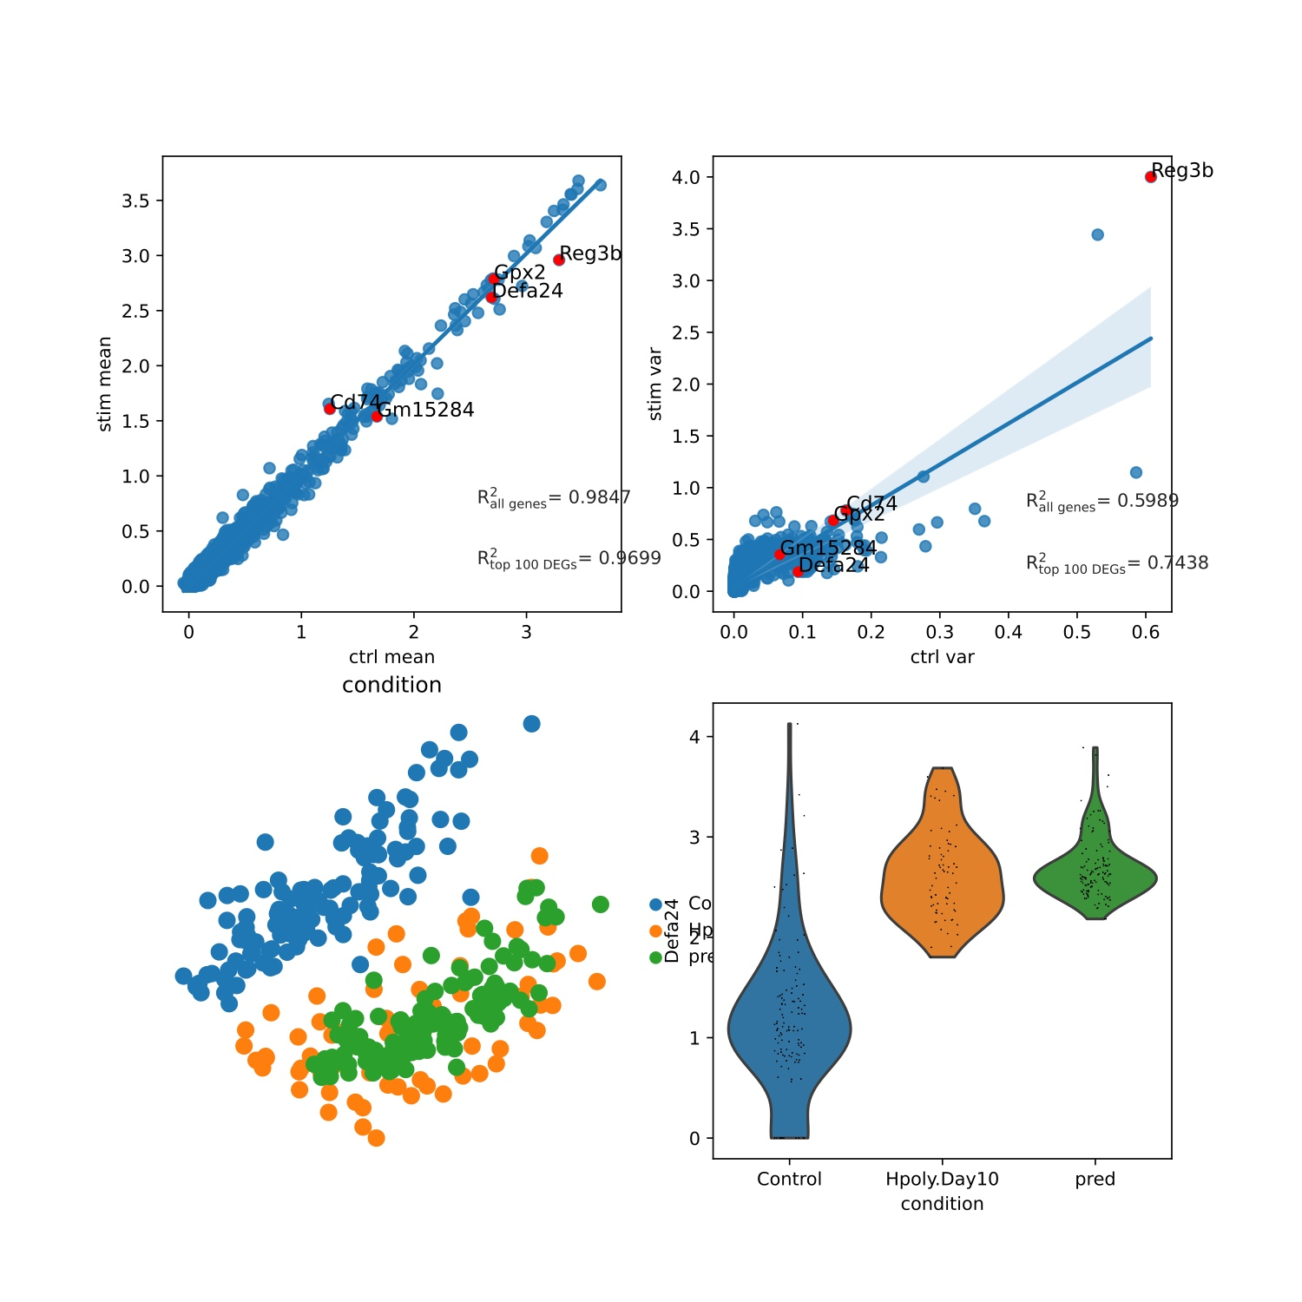
Ours
scgen
Hpoly: TA.Early

Slide 8
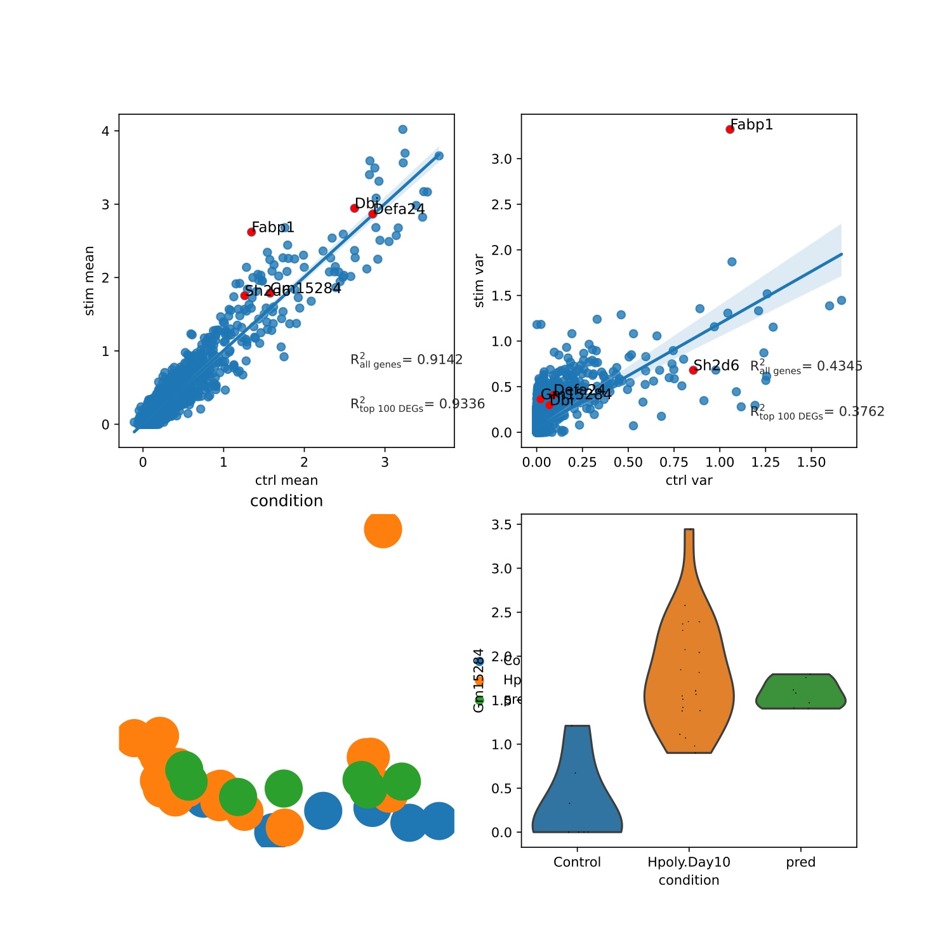
Ours
scgen
Hpoly: Tuft

Slide 9
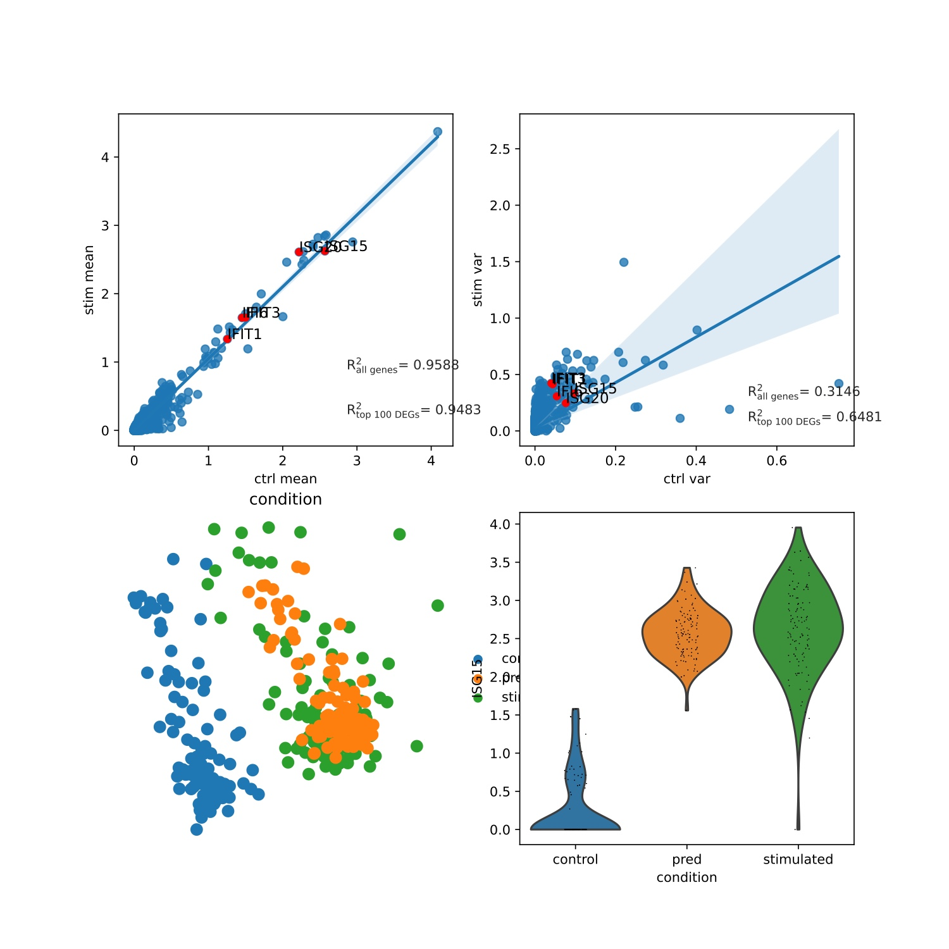
Ours
scgen
Pbmc: B

Slide 10
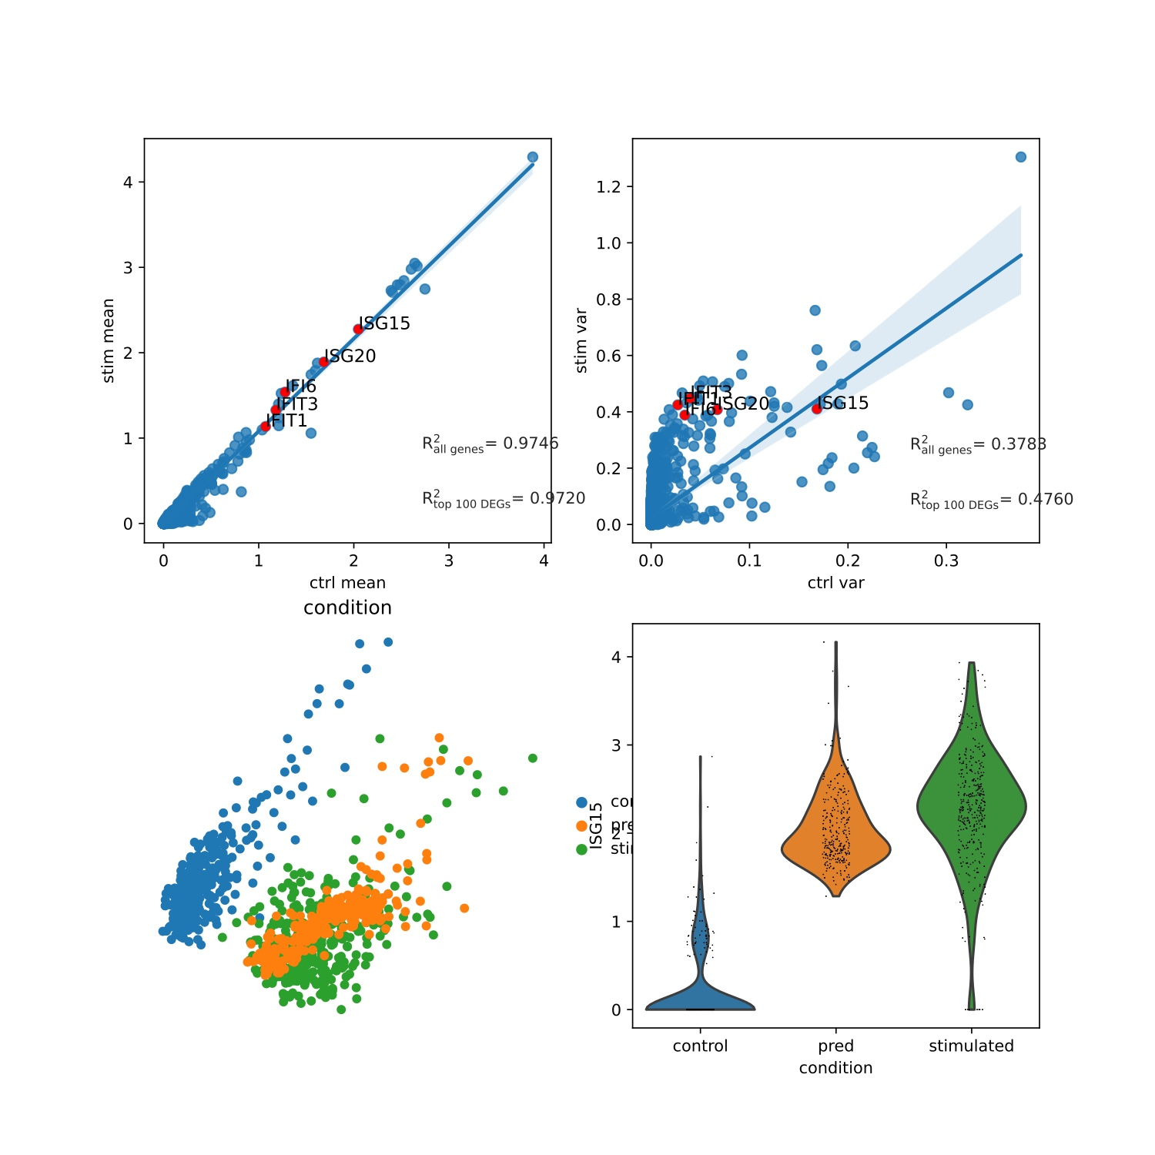
Ours
scgen
Pbmc: CD4T

Slide 11
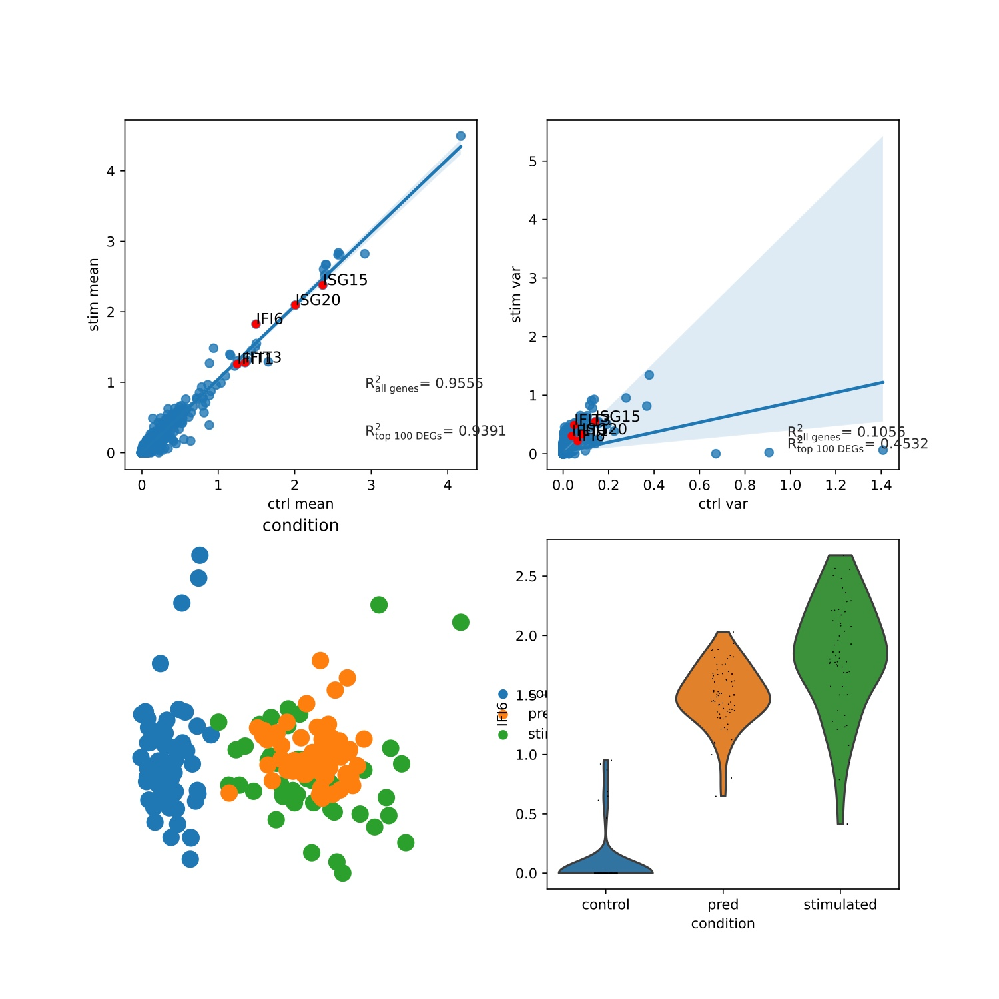
Ours
scgen
Pbmc: CD8T

Slide 12
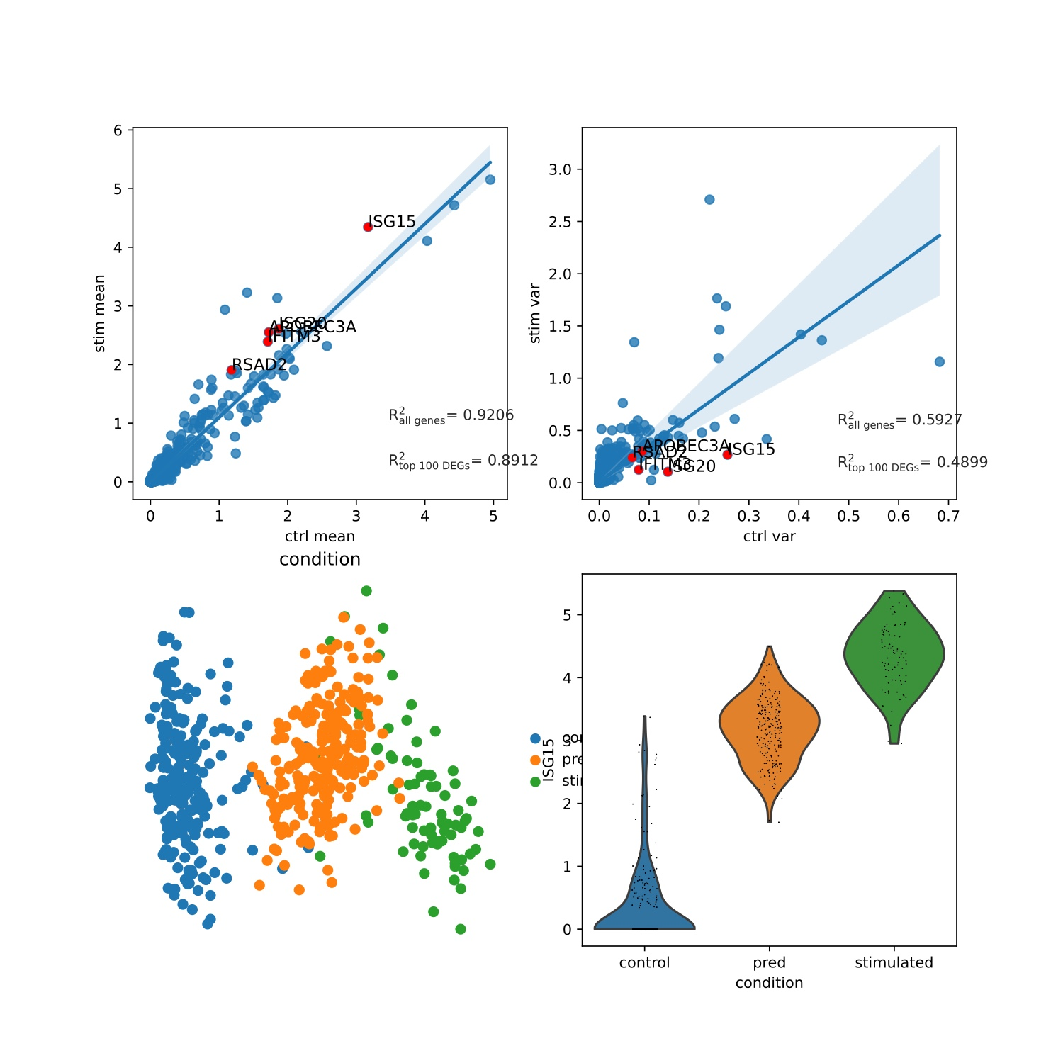
Ours
scgen
Pbmc: CD14+Mono

Slide 13
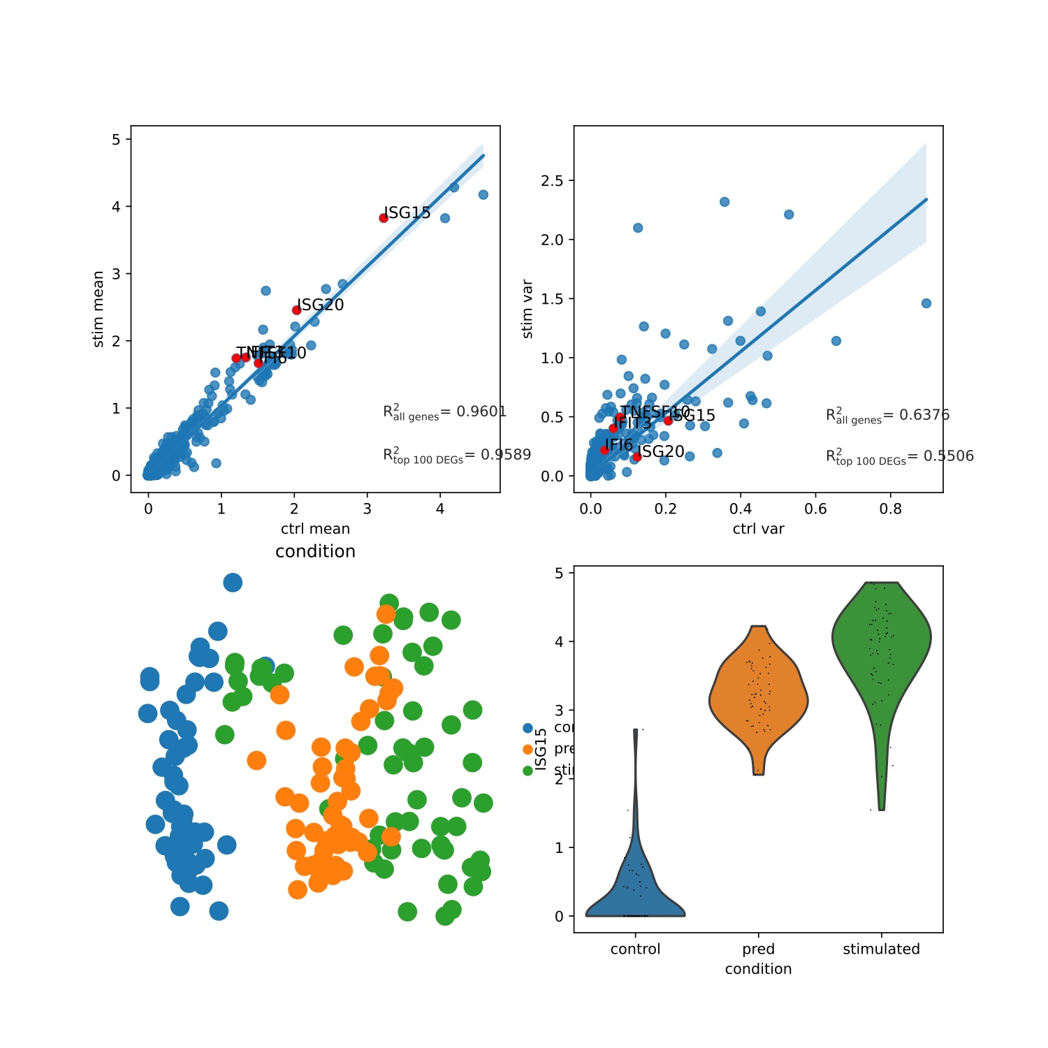
Ours
scgen
Pbmc: Dendritic

Slide 14
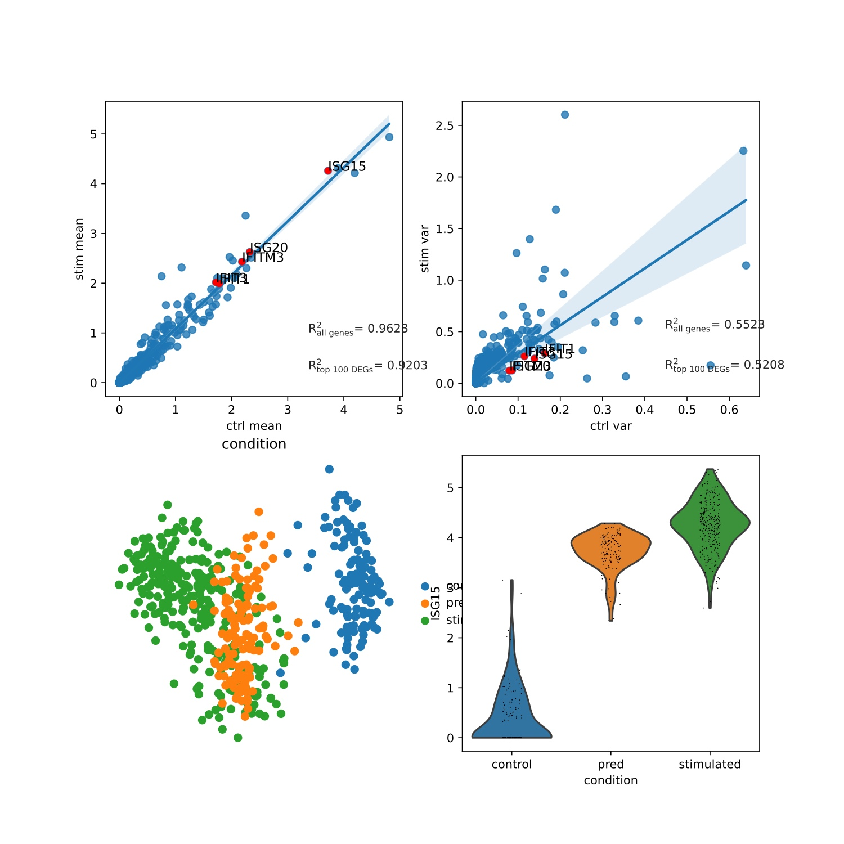
Ours
scgen
Pbmc: FCGR3A+Mono

Slide 15
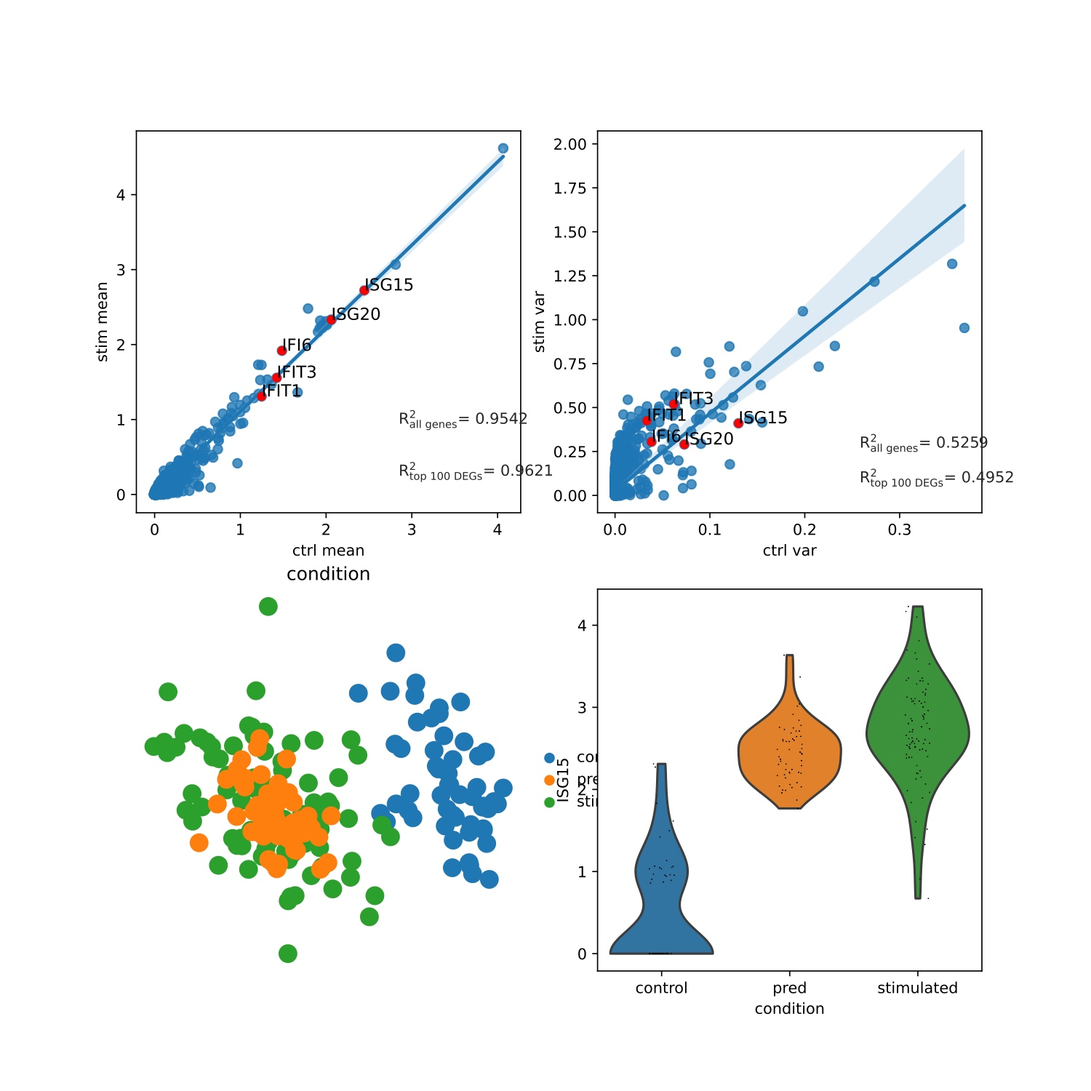
Ours
scgen
Pbmc: NK

Slide 16
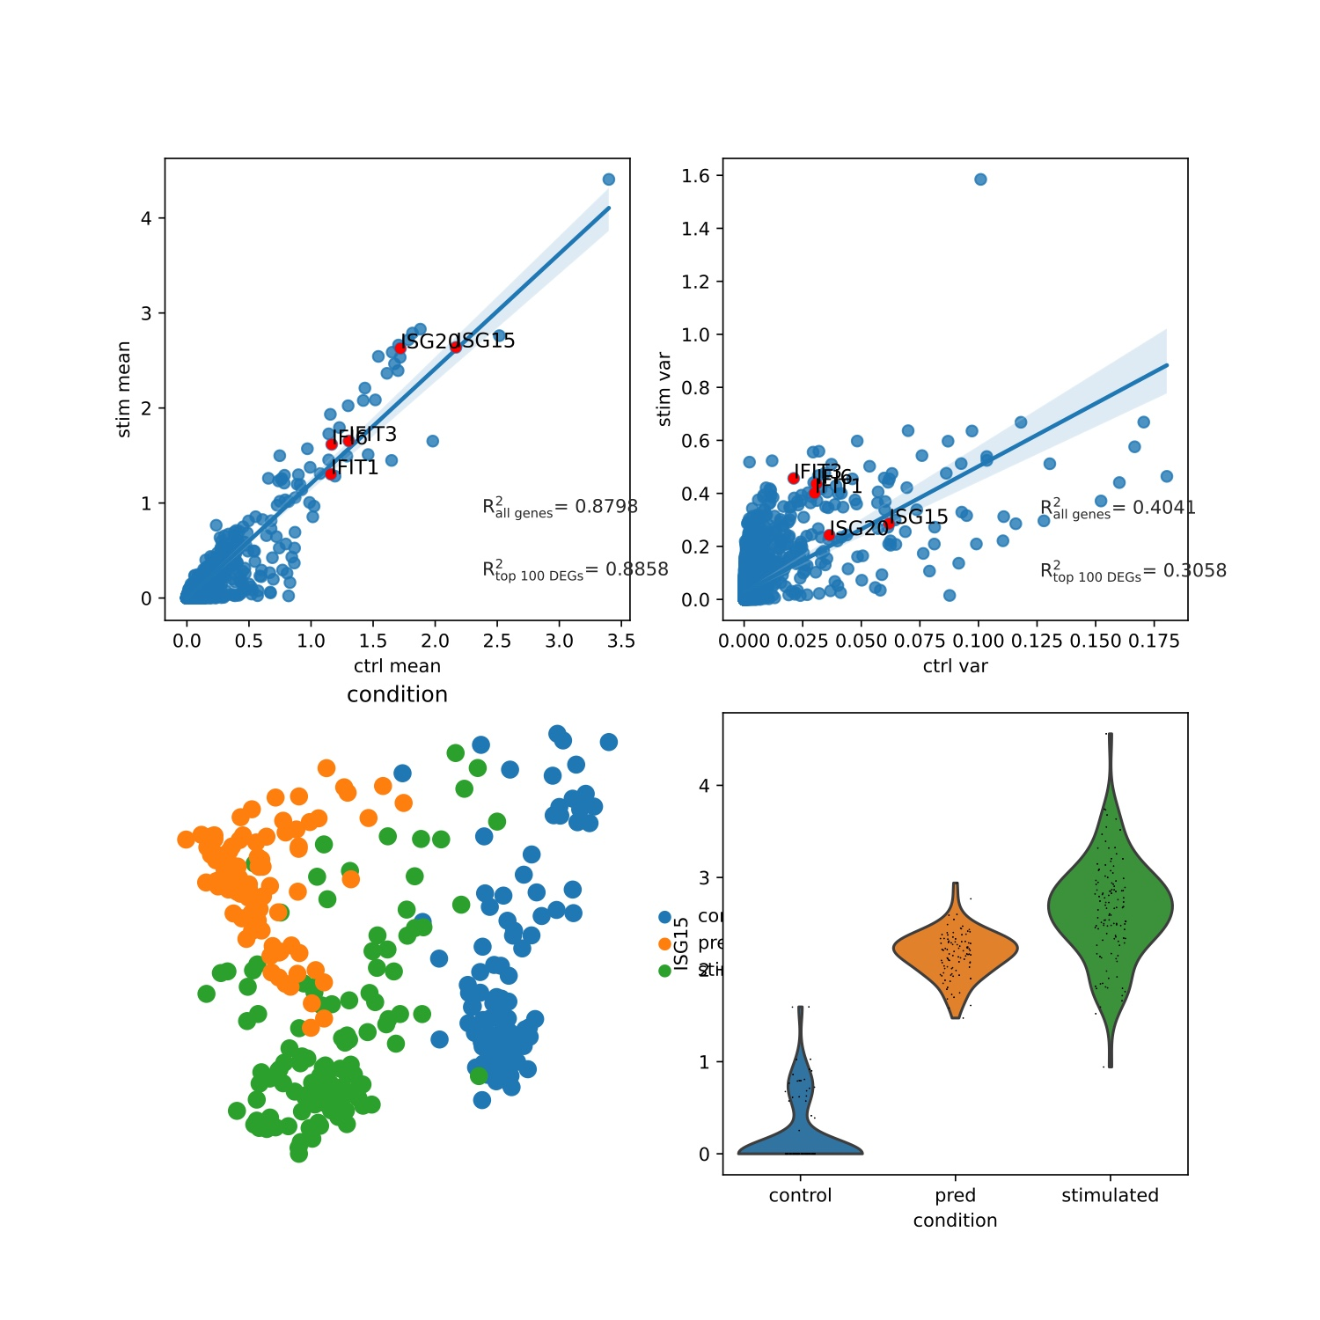
Ours
scgen
Study: B

Slide 17
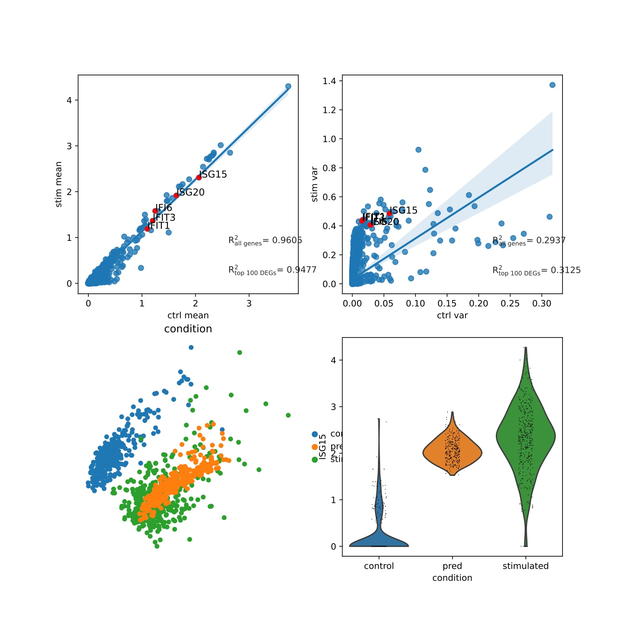
Ours
scgen
Study: CD4T

Slide 18
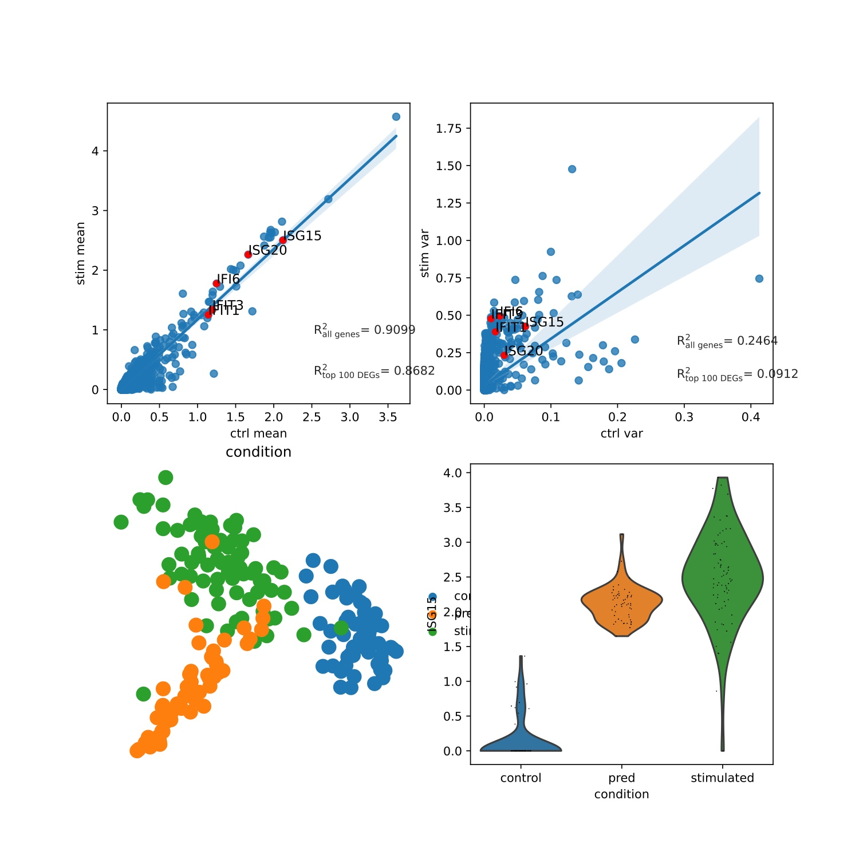
Ours
scgen
Study: CD8T

Slide 19
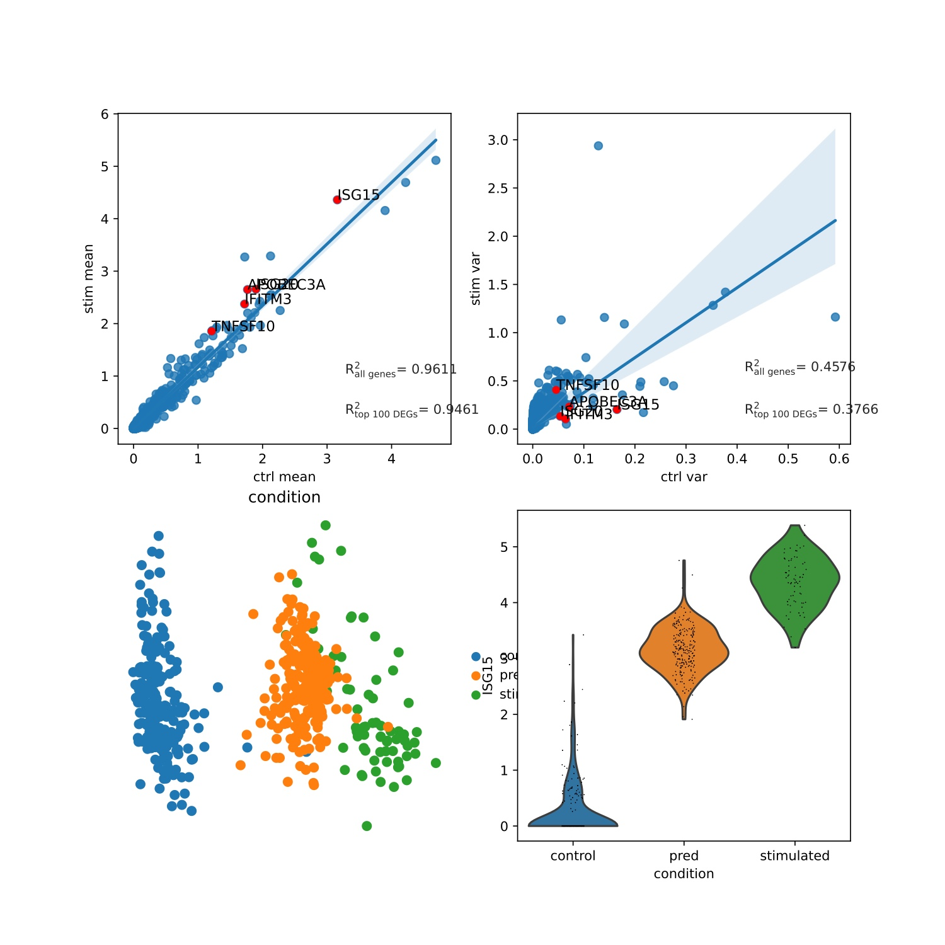
Ours
scgen
Study: CD14+Mono

Slide 20
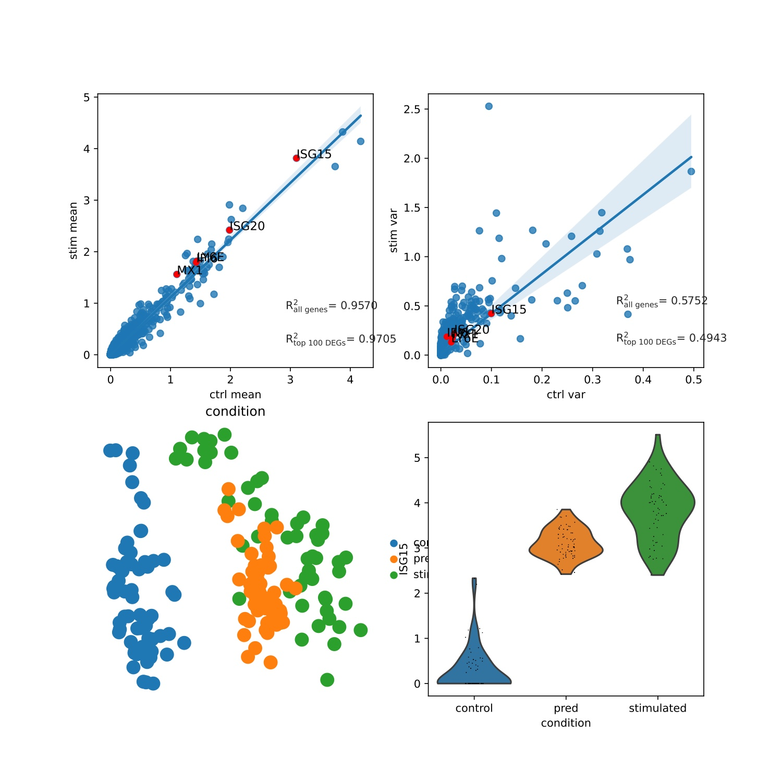
Ours
scgen
Study: Dendritic

Slide 21
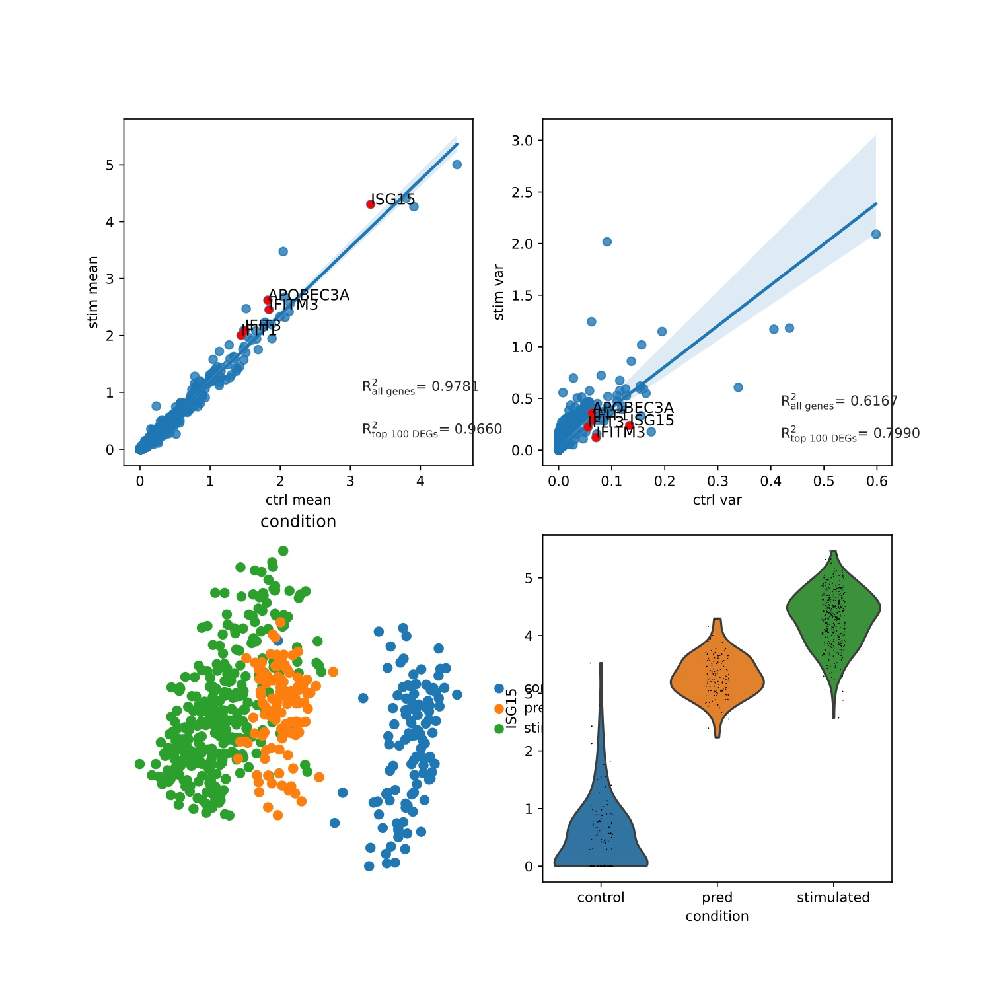
Ours
scgen
Study: FCGR3A+Mono

Slide 22
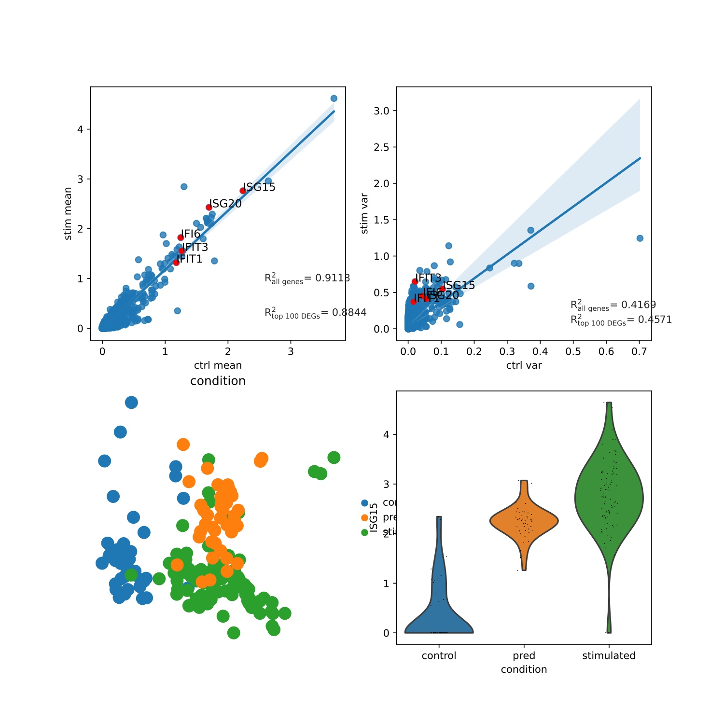
Ours
scgen
Study: NK

